Slide 1
Big Mountain Resort
Ticket Price Modeling

Slide 2
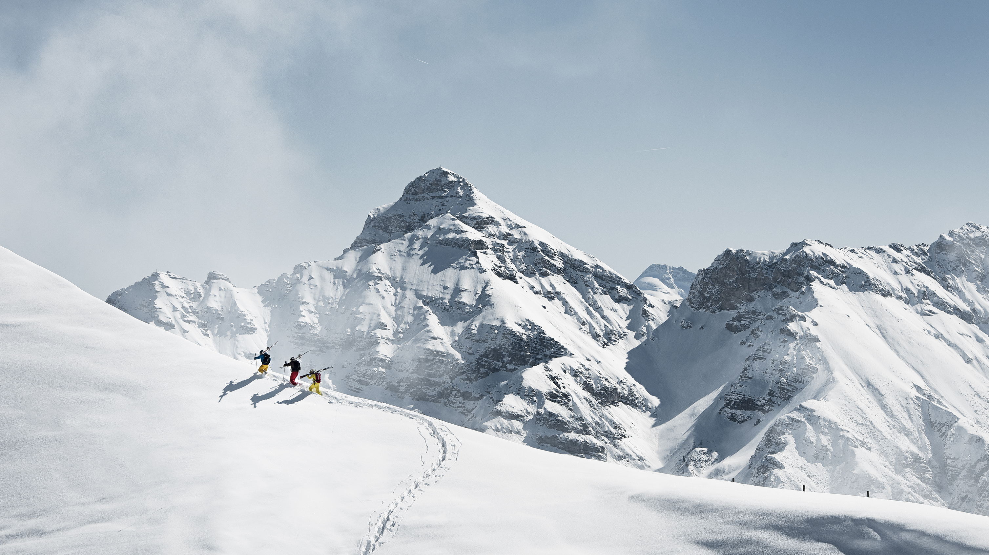
Problem Identification
Big Moutain Resort provides a premium ski experience (excellent views, runs, chairs, etc.)
Ticket Price Increase?
Reduce Operating Costs?
Constraint: provide same premium service

Slide 3
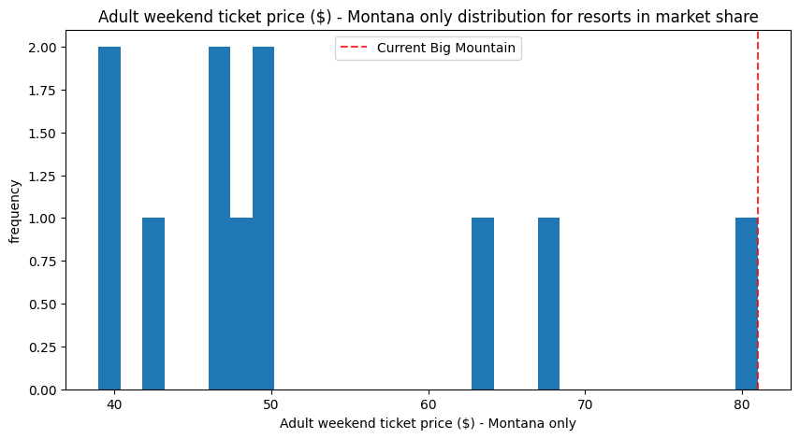
Key Findings
Ticket price increase up to $95 (+/- $10) supported by model
NB: Big Mountain Resort already highest priced ticket in Montana

Slide 4
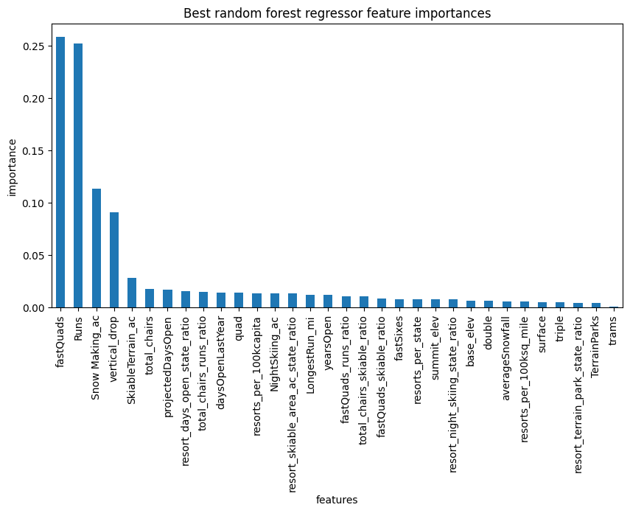
Key Findings
Key drivers of price (in the available data) are:
Number of fast quads
Number of runs
Snow making area
Vertical drop

Slide 5
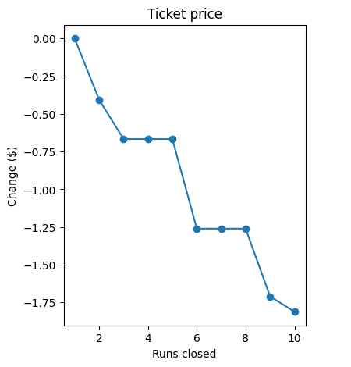
Key Findings
Closing one run has no impact on price
Closing 3, 4, or 5 runs has the same impact on price

Slide 6
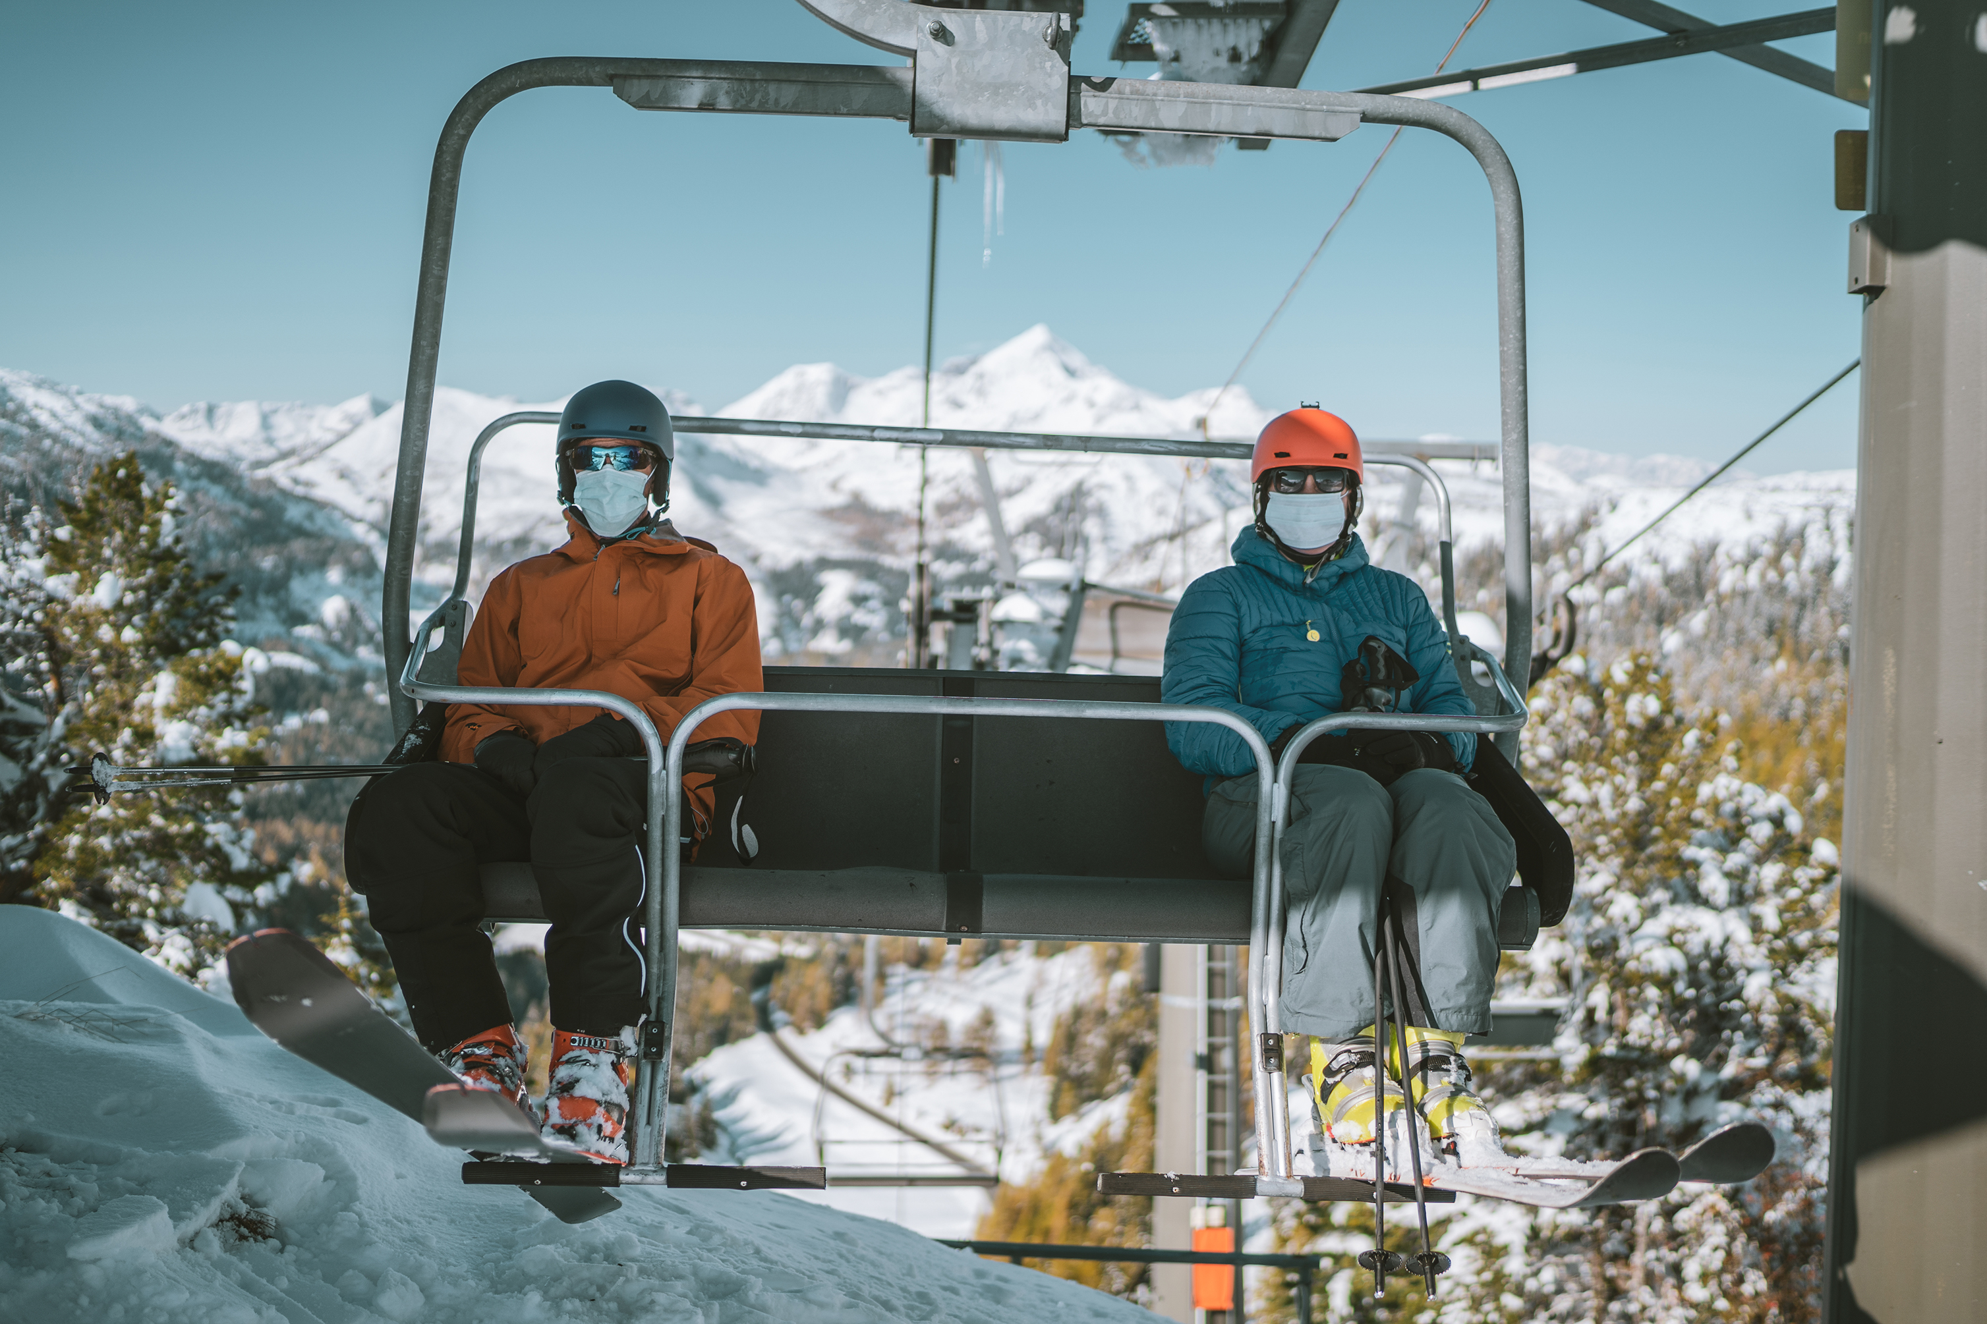
Key Findings
New services unlikely to be profitable if they need a new chairlift
(e.g. increasing vertical drop, number of runs)
NB: Latest chair cost $1.5M last season

Slide 7
Recommendations
Increase price incrementally over several seasons with final target ticket price of $90
Track visitors, revenue
Close one run, and perhaps up to 5 depending on remaining run coverage and possible cost optimization
Track run usage

Slide 8
Modeling Results – Best Model
Best Model is Random Forest model
Best Params: N=69; replace missing prices with median price
Ticket price $95.97; Mean absolute error $10.39
Benefits of Random Forest:
Reports feature importance; allows management “gut check”
Allows future models to use categorical data
Easily made available to run new operation scenarios

Slide 9
Modeling Results – Scenarios
Scenario | Result
1. Close up to 10 runs | Closing 1 run: no impact on ticket price Closing 2 runs: -$0.40 Closing 3-5 runs: -$0.67
2. Add 1 run, increase vertical drop 150 ft, add chair | Increase ticket price $1.99 Additional revenue unlikely to offset cost of new chair
3. Same as 2, but add 2 acres of snow making | No additional ticket price lift (i.e. same as scenario 2)
4. Increase run length 0.2 mi, Increase snow making area 4 acres | No impact

Slide 10
Modeling Results – Limitations
All states pooled – Are higher-cost states good comparison to Montana? (e.g. California, New York)
No revenue/visitor information – Operational scenarios only estimate revenue impacts

Slide 11
Additional Data?
Historical data to quantify impacts of service & price changes
Visitors
Operational costs of services (e.g. chairs, run maintenance, quads, trams, etc.)
Installation costs of new services

Slide 12
Summary and Conclusions
Recommendations
Increase ticket price to $90 per day, close 1-5 runs
Incorporate management feedback and revise model?
Release final model to management team
Incorporate additional data?
Historical data, visitors, operational costs

